Slide 1
AlgoExpert
CSE - 326
Information & System Design
SCOPE FIXATION
1805001 - Md. Mehrab Haque
1805003 - Rabib Jahin Ibn Momin
1805009 - MD. Zarzees Uddin Shah
1805015 - Ahmed Mahir Sultan Rumi
1805021 - Abdus Samee
1805024 - Zannatul Naim

Slide 2
What is AlgoExpert?
AlgoExpert is a platform for software engineers to efficiently prepare themselves for technical interviews. It allows the users to work through various problems in computer science and ace their coding interviews.
The platform suggests a user a problem based on their performance and keeps track of their problem solving history. Users can practice problems of different difficulty levels and track their progress.

Slide 3
Why AlgoExpert?
An interview platform solely dedicated for software engineering aspirants.
Having a detailed knowledge of the current level of a programmer is quite necessary to efficiently put effort in the correct areas
Makes the users aware of their strength and weakness in particular types of problems.
Allows an user to get acquainted with the important and famous algorithms based on the popularity.
A good educational platform and helpful for students
Free.

Slide 4
Features
Set of problems of different difficulty levels: easy, medium, hard.
Algorithmic, Puzzles, competitive, and interactive problems are available.
Problem recommendation system.
Suggests a user problems based on their performance and popularity.
Track the problem solving progress.
The platform intends to show the user his/her regularity of solving problems.
Editorial section for the problems.
Textual and video solutions are available.

Slide 5
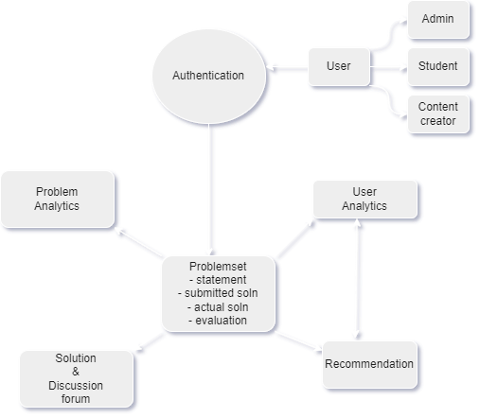

Slide 6
Inclusion List
Exclusion List
Algorithmic problems, Brainteasers , Interactive problems and many more
User recommendation system
Progress tracking
Solution and discussion forum
Mock Interview
Payment System
Competitive contests

Slide 7
Constraints
Users are required to have access to internet.
Requirement of large amount of user generated data for analytics outcome.
Contents are needed to be updated on regular basis for user retention.

